Slide 1
HOUSE CHAMONIX
AUASBLICK
N$ 15,800,000.00

Slide 2
DESCRIPTION
With its 180 degree views, this East facing home, designed for two families, guarantees a spectacular sunrise, each one more beautiful than the last! This property consists of two separate homes, there is two or more of everything, even the view!
The 1st floor has a double volume lounge, mezzanine family area, study area, 4 bedrooms, 3 bathrooms, kitchen, scullery, and dining area with glass doors leading out onto the lovely rooftop area.
The 2nd home on the 2nd floor has its own street entrance and carport, 3 bedrooms, 3 bathrooms, study, full kitchen, dining area and 117 sqm entertainment area, which could be used as offices.
There is a large area to make a garden and a paved parking area, ideal for the office staff
The lower level has a one-bedroom flatlet, 3 car garage and an office.

Slide 3
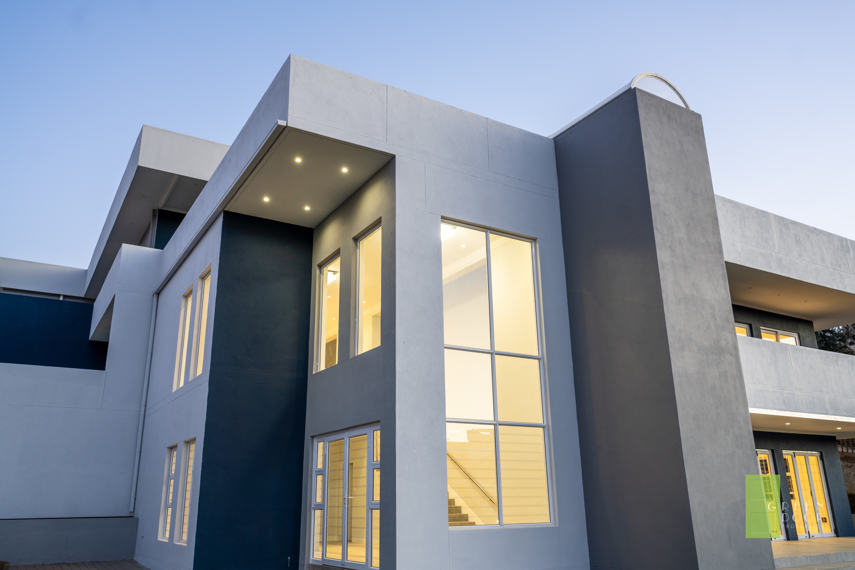
18 CHAMONIX STR
AUASBLICK
WINDHOEK
NAMIBIA
7 BEDROOMS
6 BATHROOMS
2 FULL KITCHENS
2 DINING ROOMS
1 FORMAL LOUNGE
3 LIVING AREAS
117 SQM ENTERTAINMENT AREA
2 OFFICES
2 GUEST WC
3 CAR GARAGE
1 CARPORT
PARKING AREA
GARDEN AREA
2 ENTRANCES
ENDLESS VIEWS

Slide 4
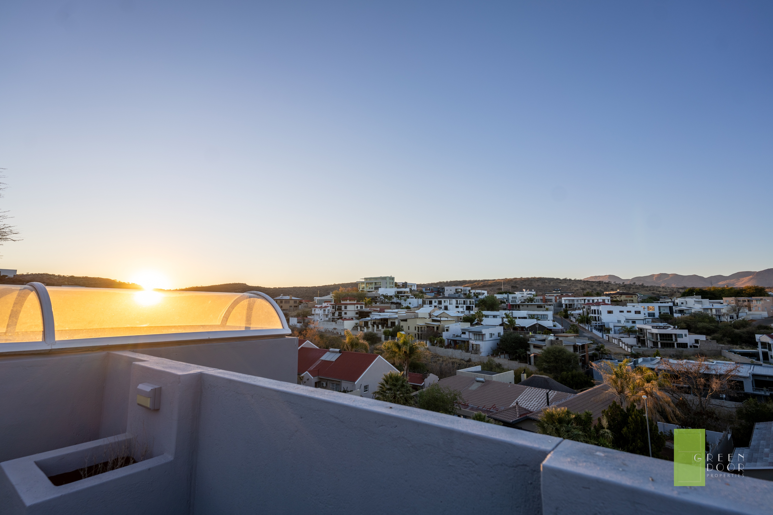
SUNRISE AND VIEW TO THE EAST

Slide 5
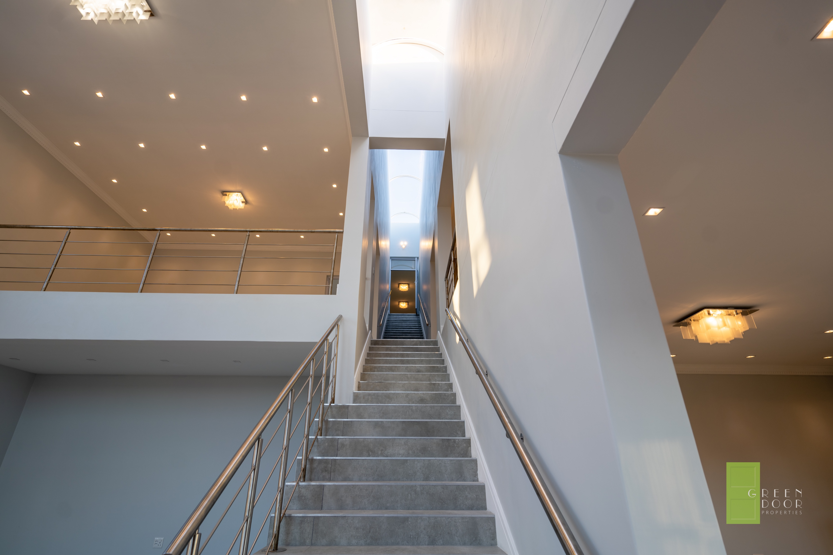
STAIRCASE TO 2ND HOME

Slide 6
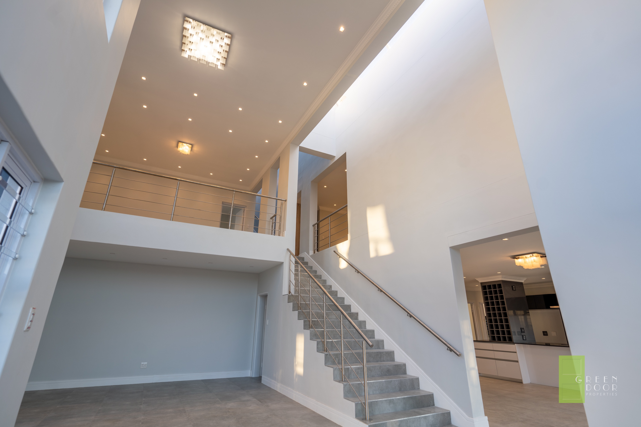
HOME 1 – DOUBLE VOLUME - LOUNGE

Slide 7
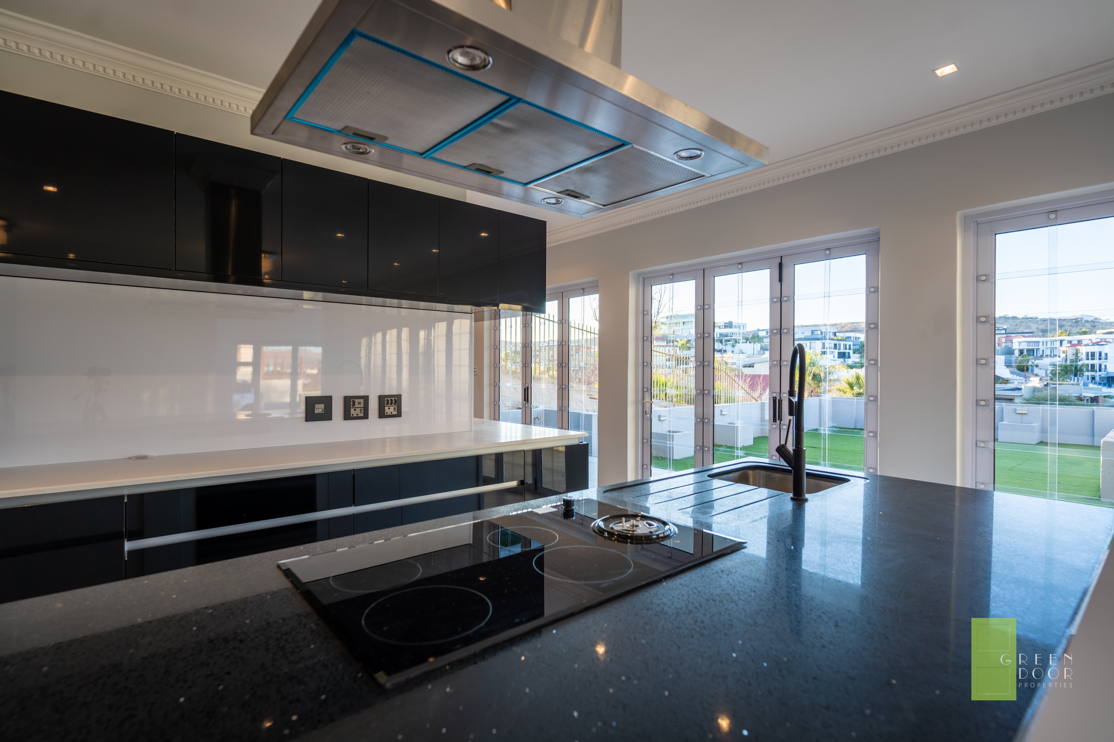
HOME 1 - KITCHEN

Slide 8
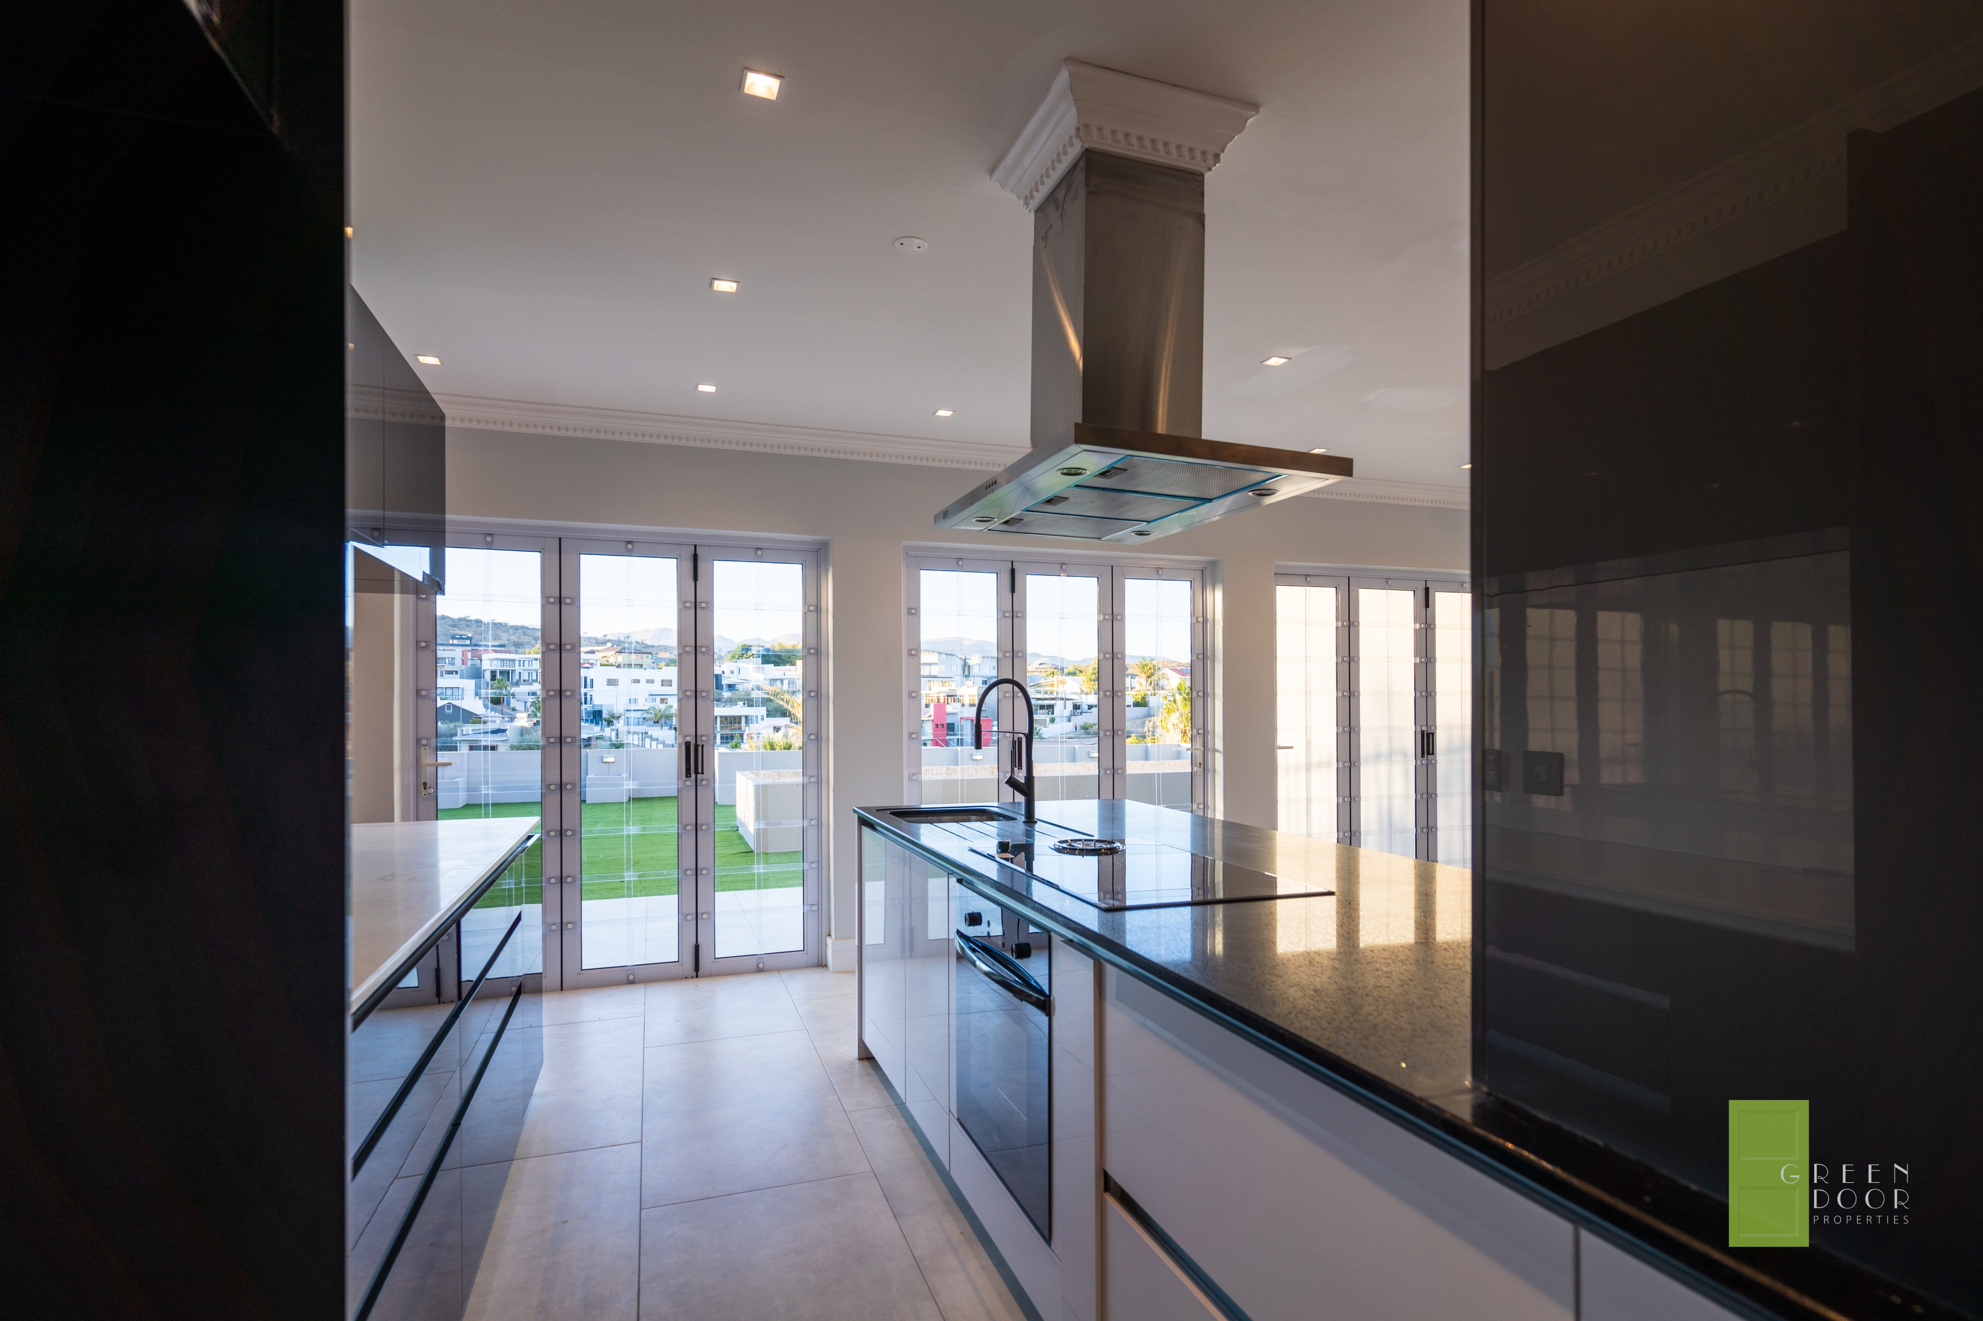
HOME 1 - KITCHEN

Slide 9
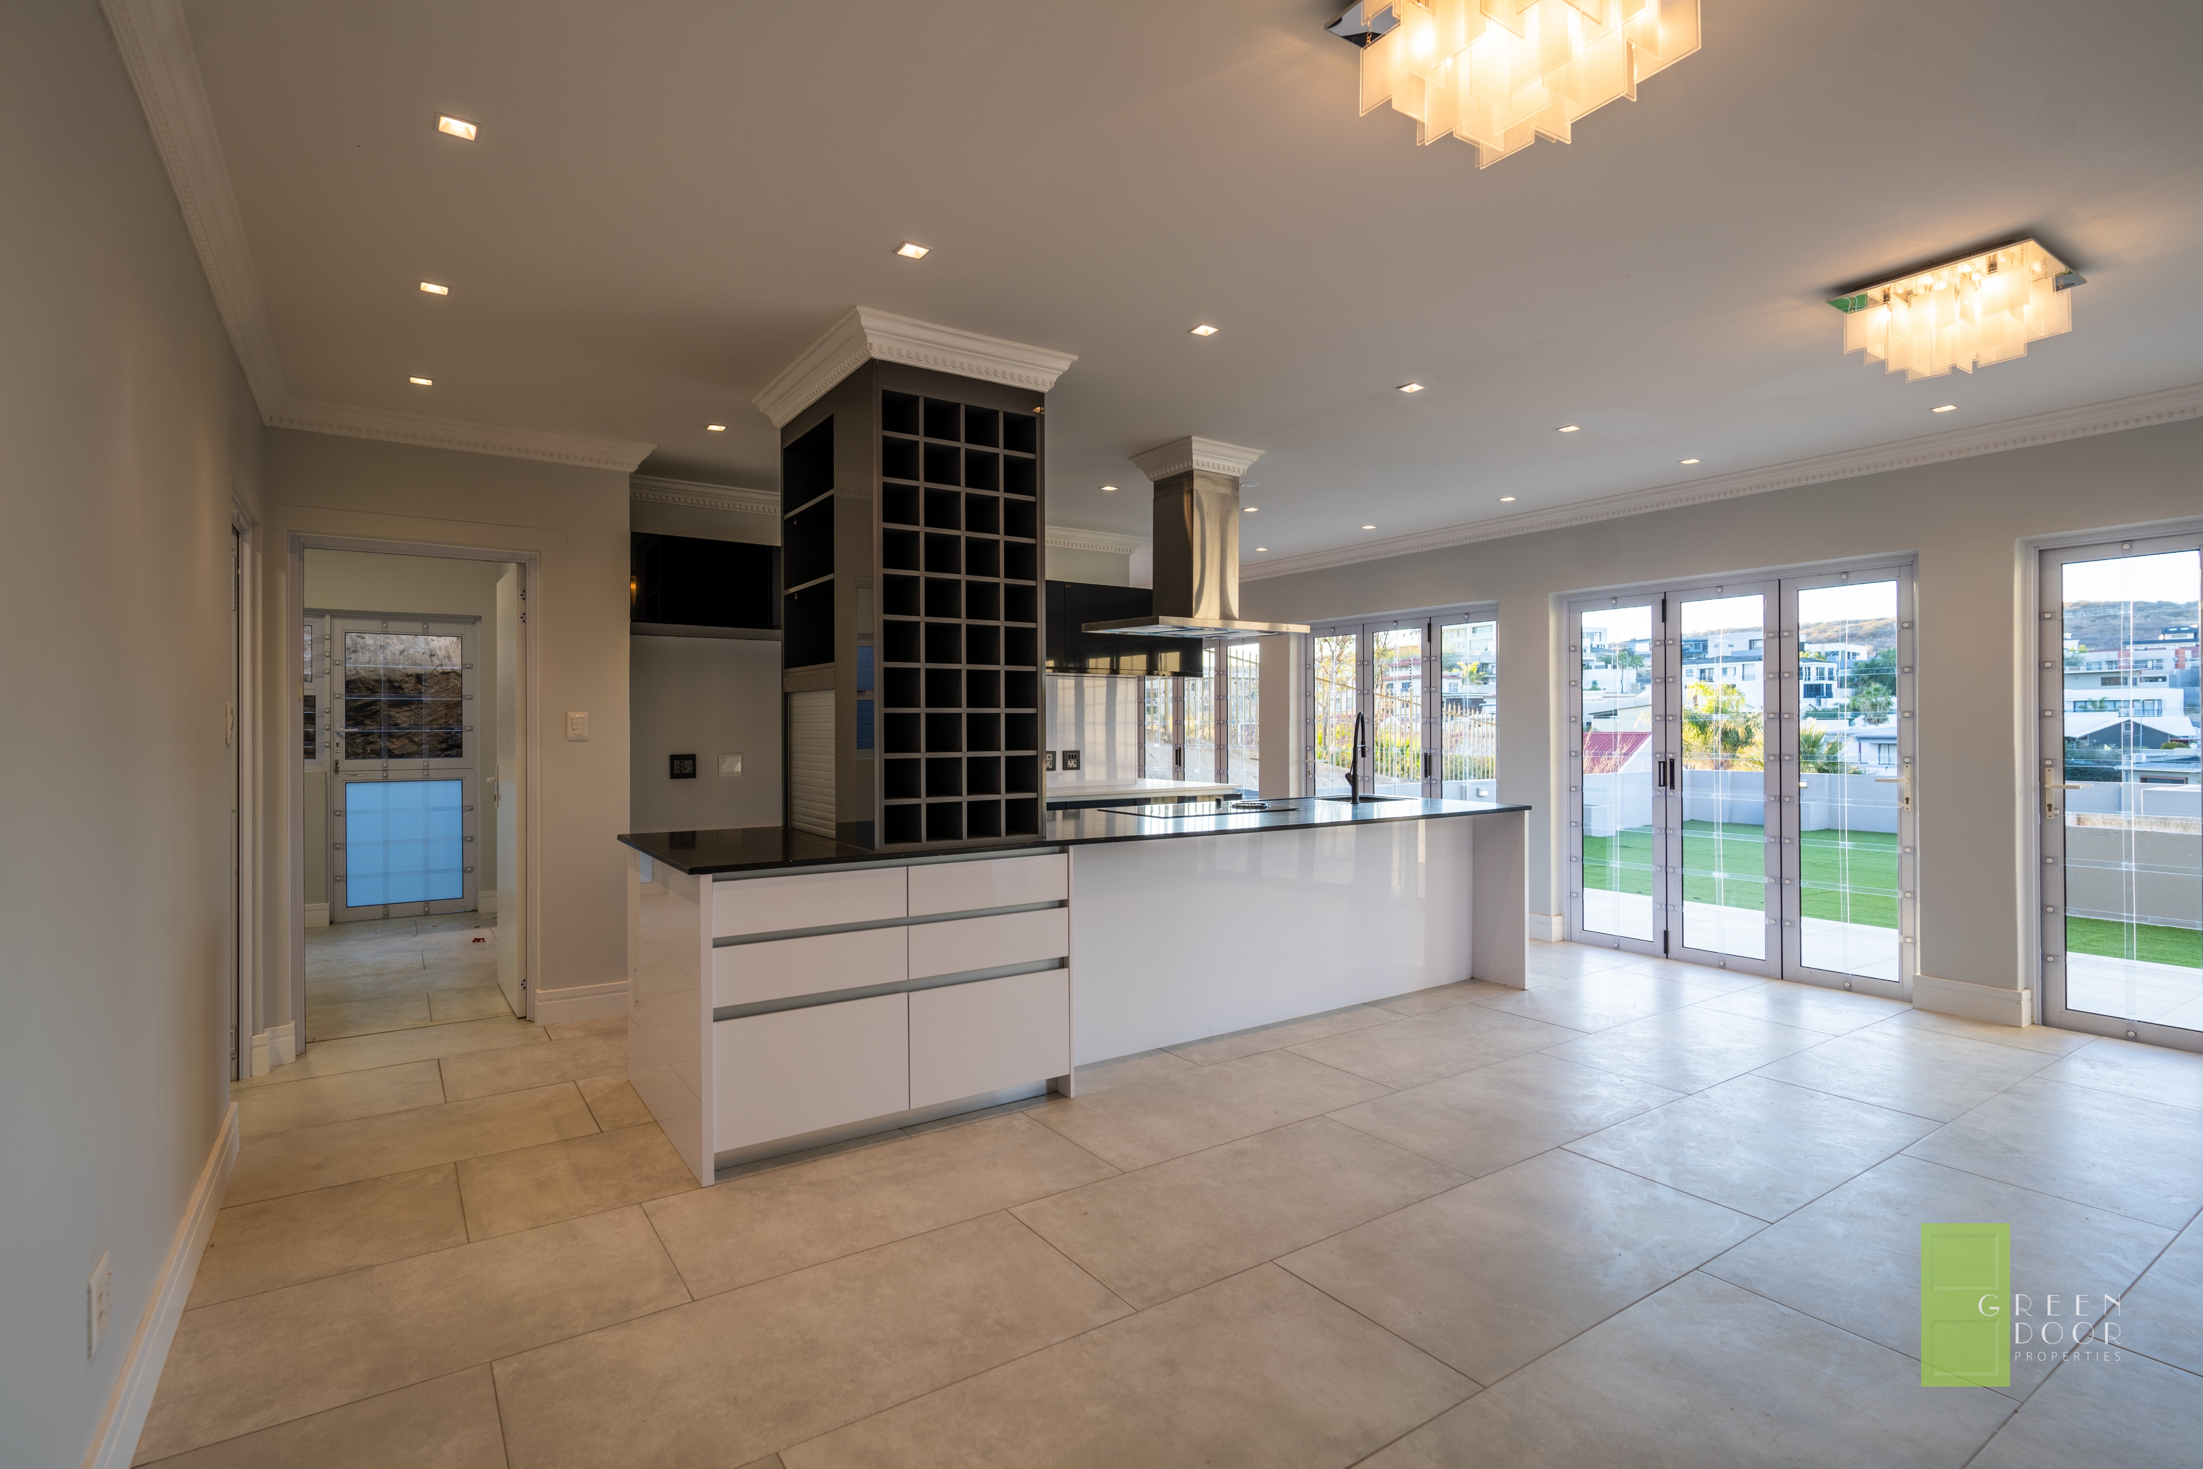
HOME 1- KITCHEN

Slide 10
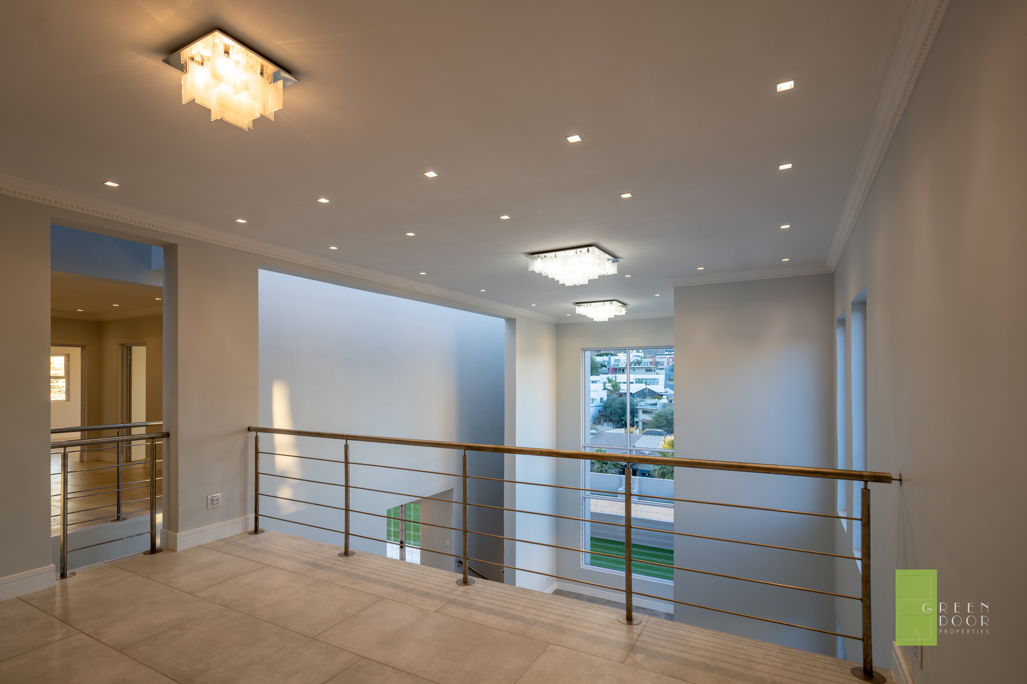
HOME 1 – MEZZANINE LEVEL

Slide 11
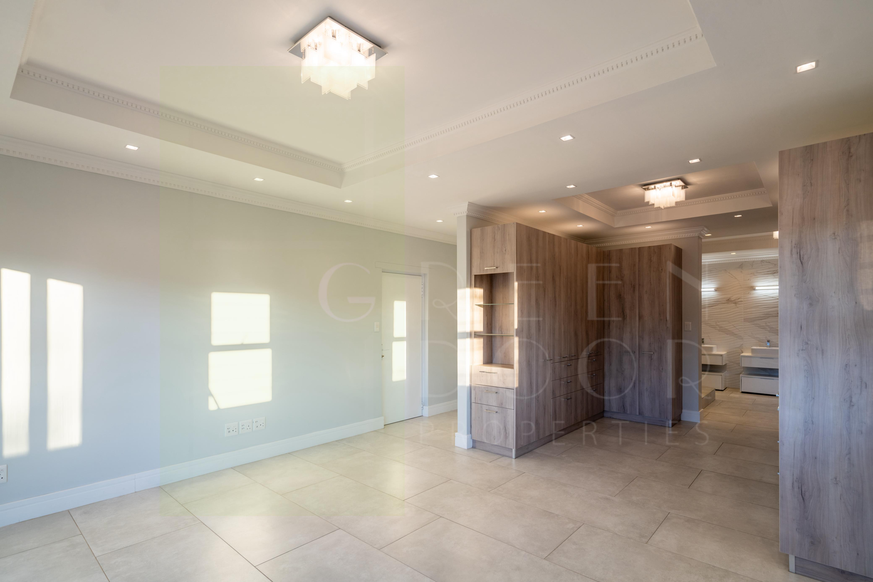
HOME 1- MAIN BEDROOM

Slide 12
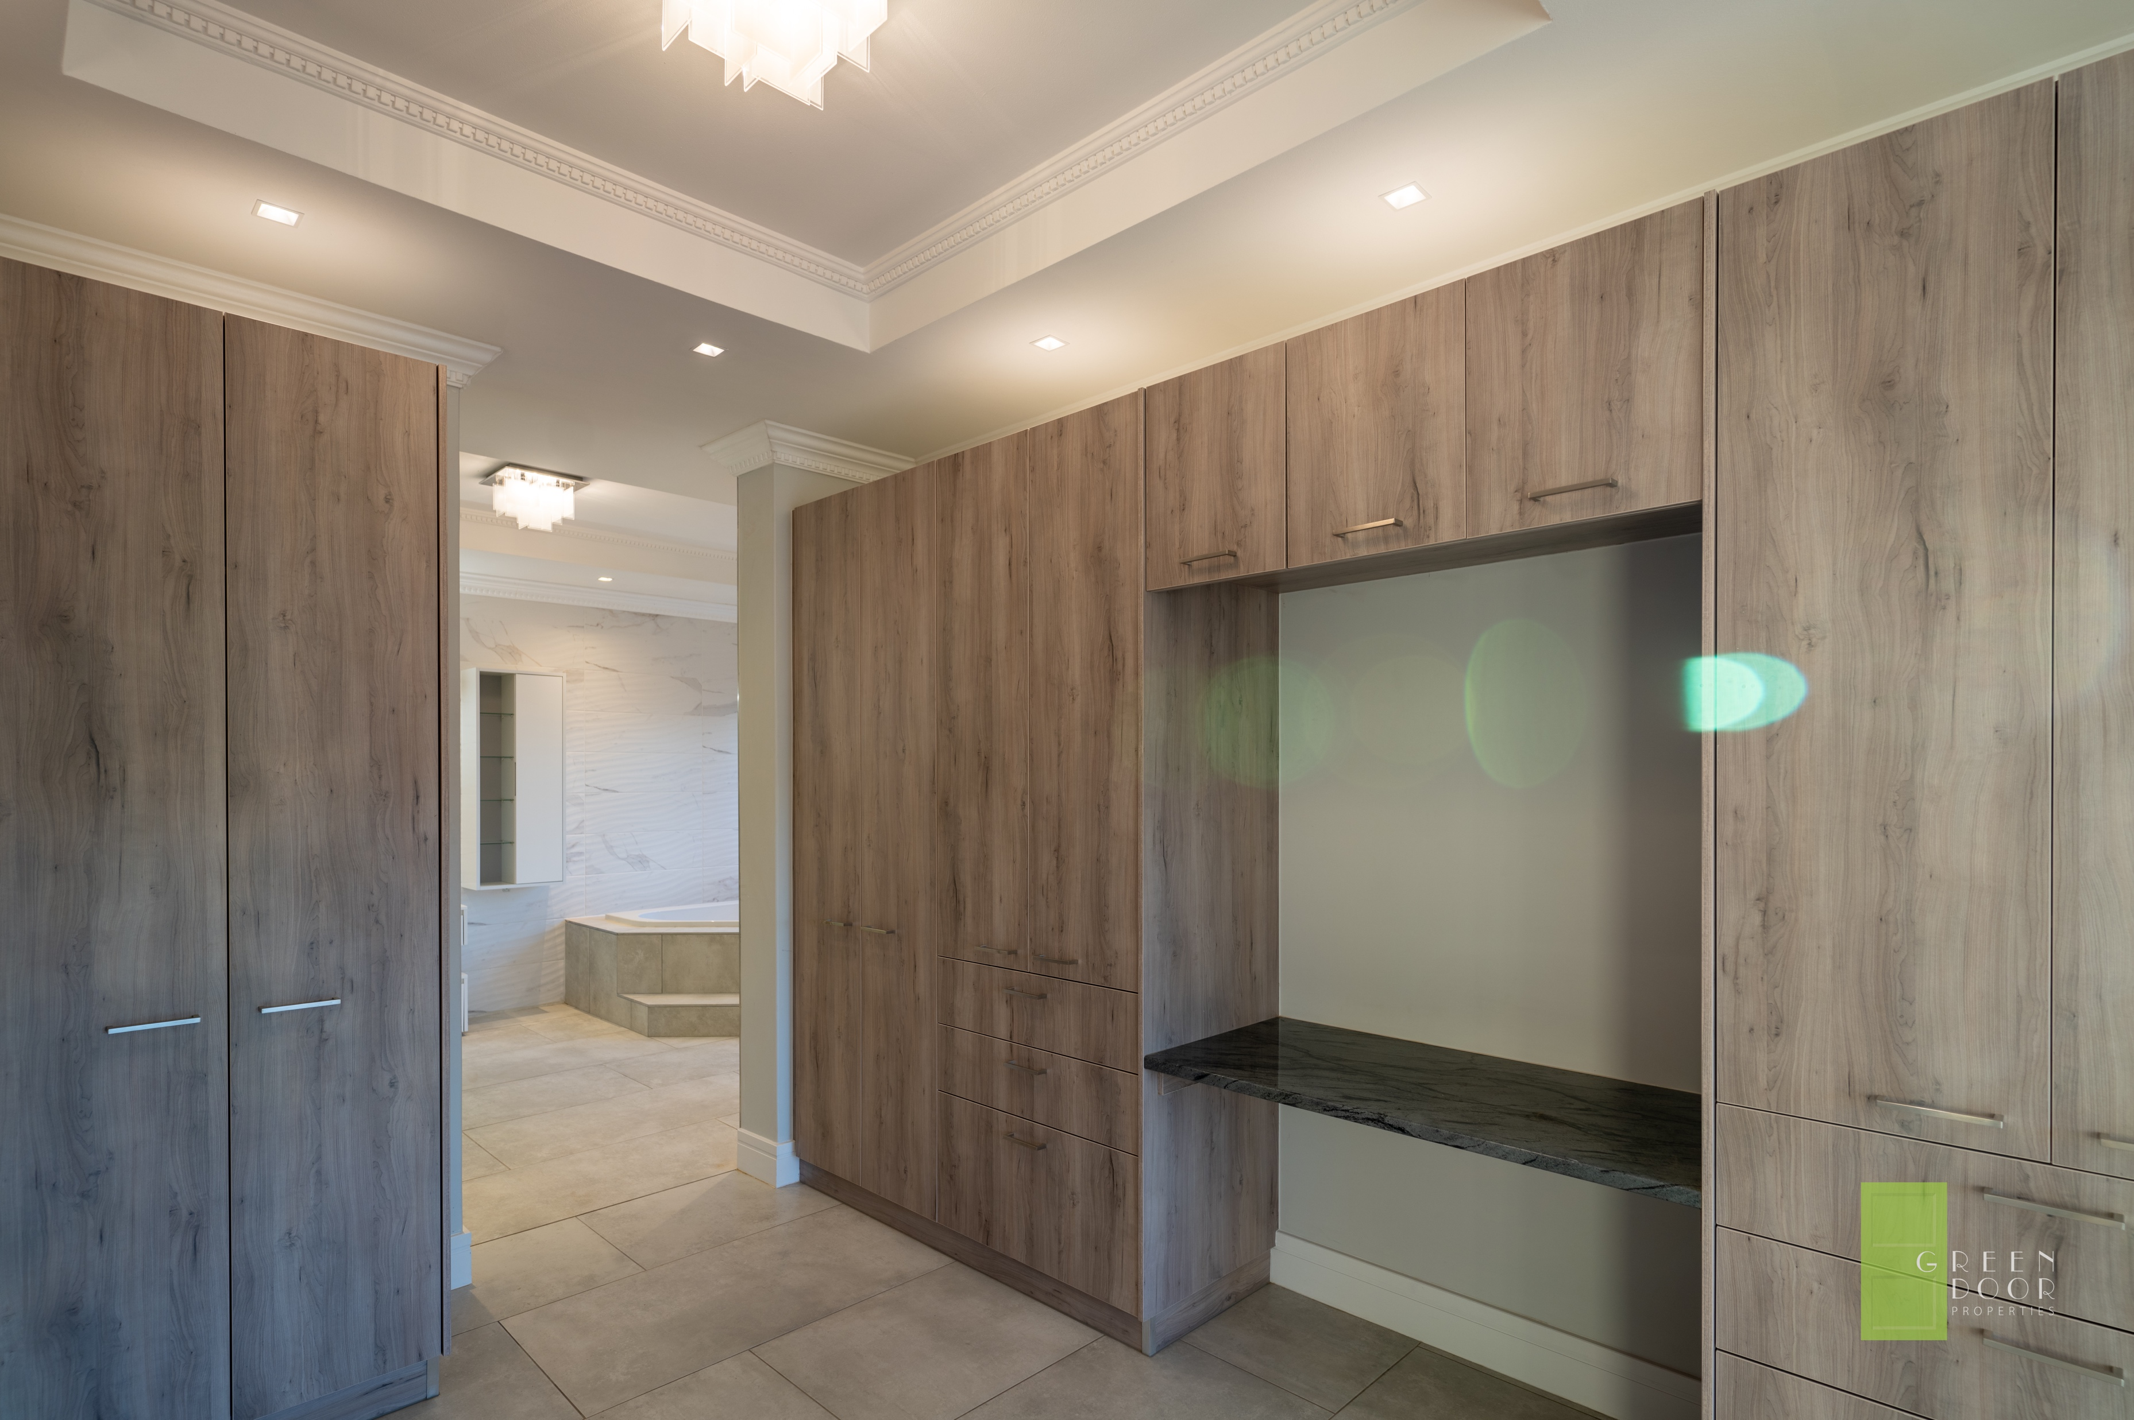
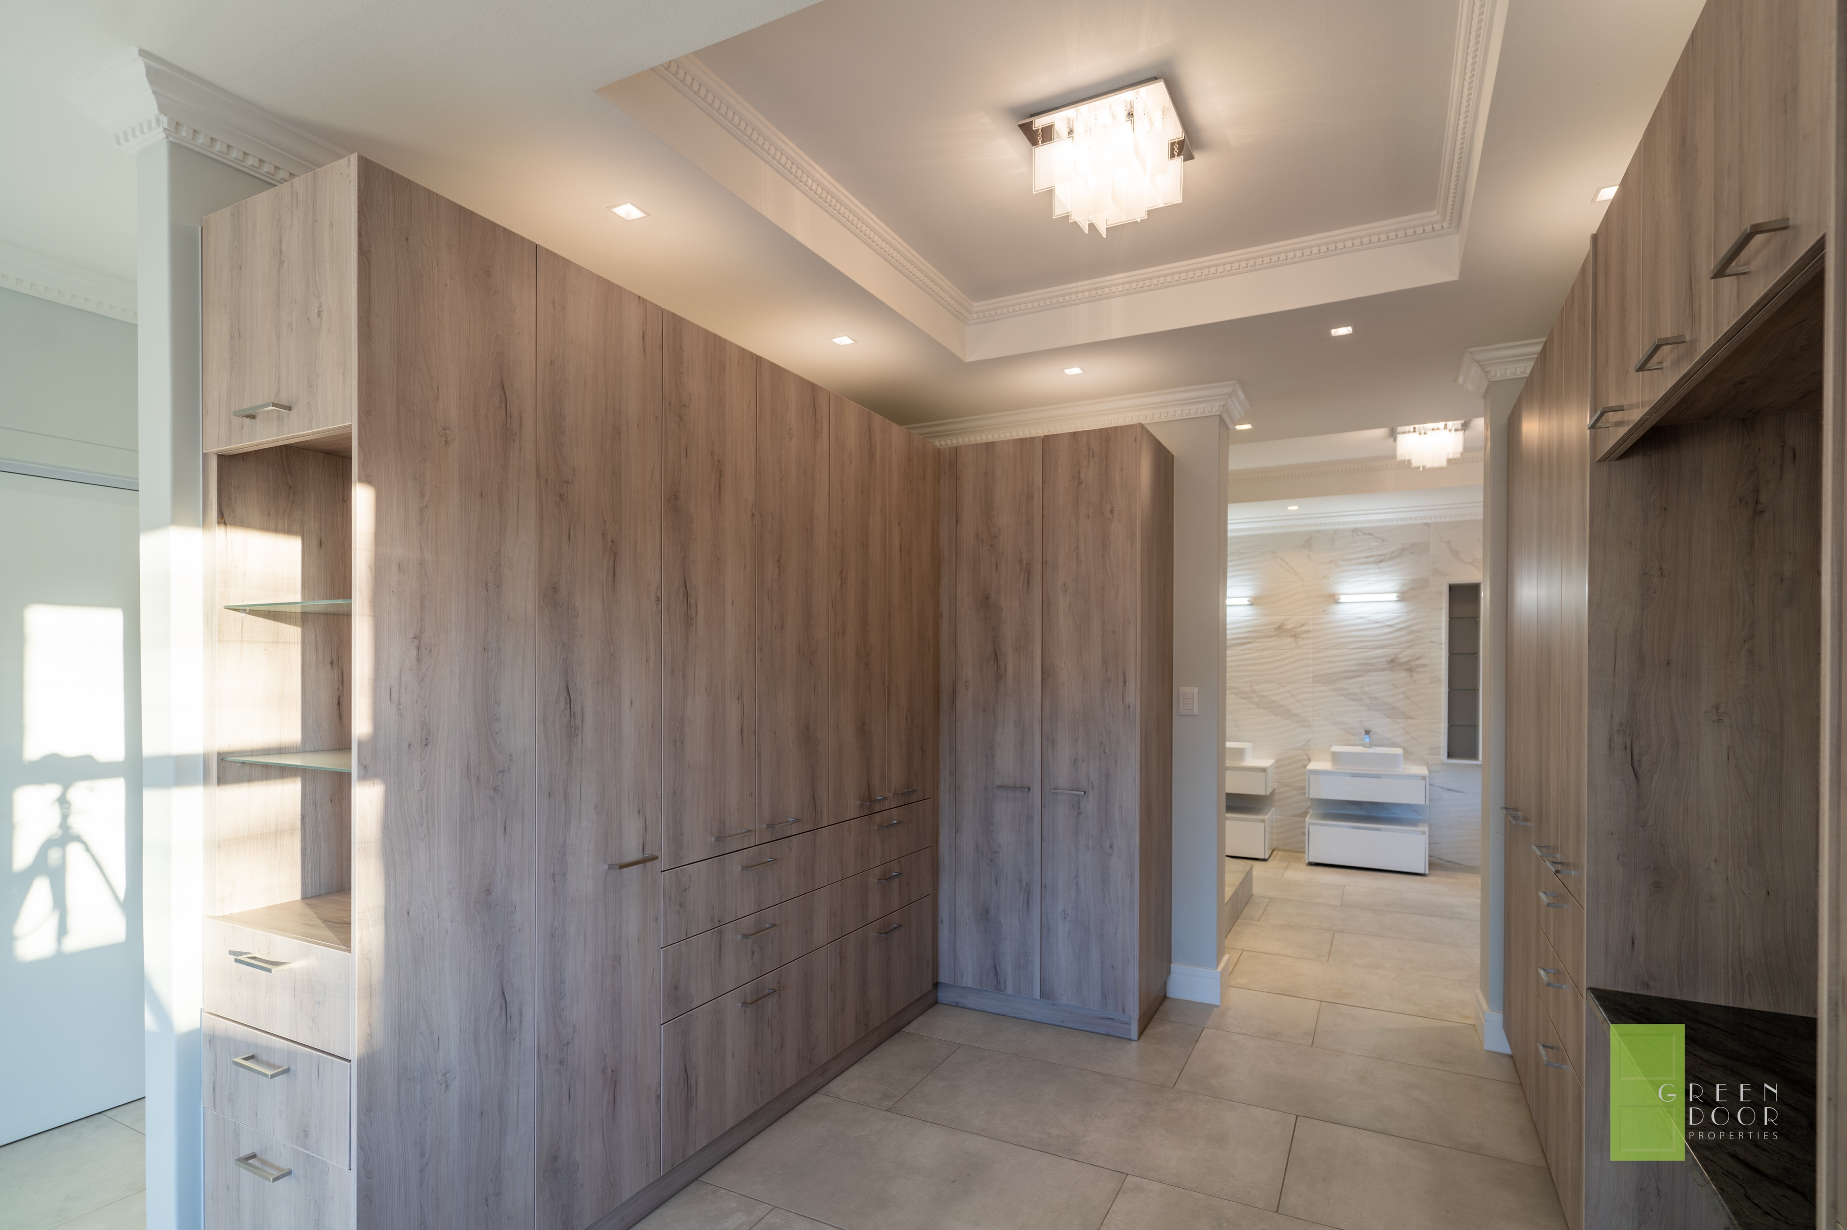
HOME 1 – MAIN BEDROOM – WALK IN CLOSET

Slide 13
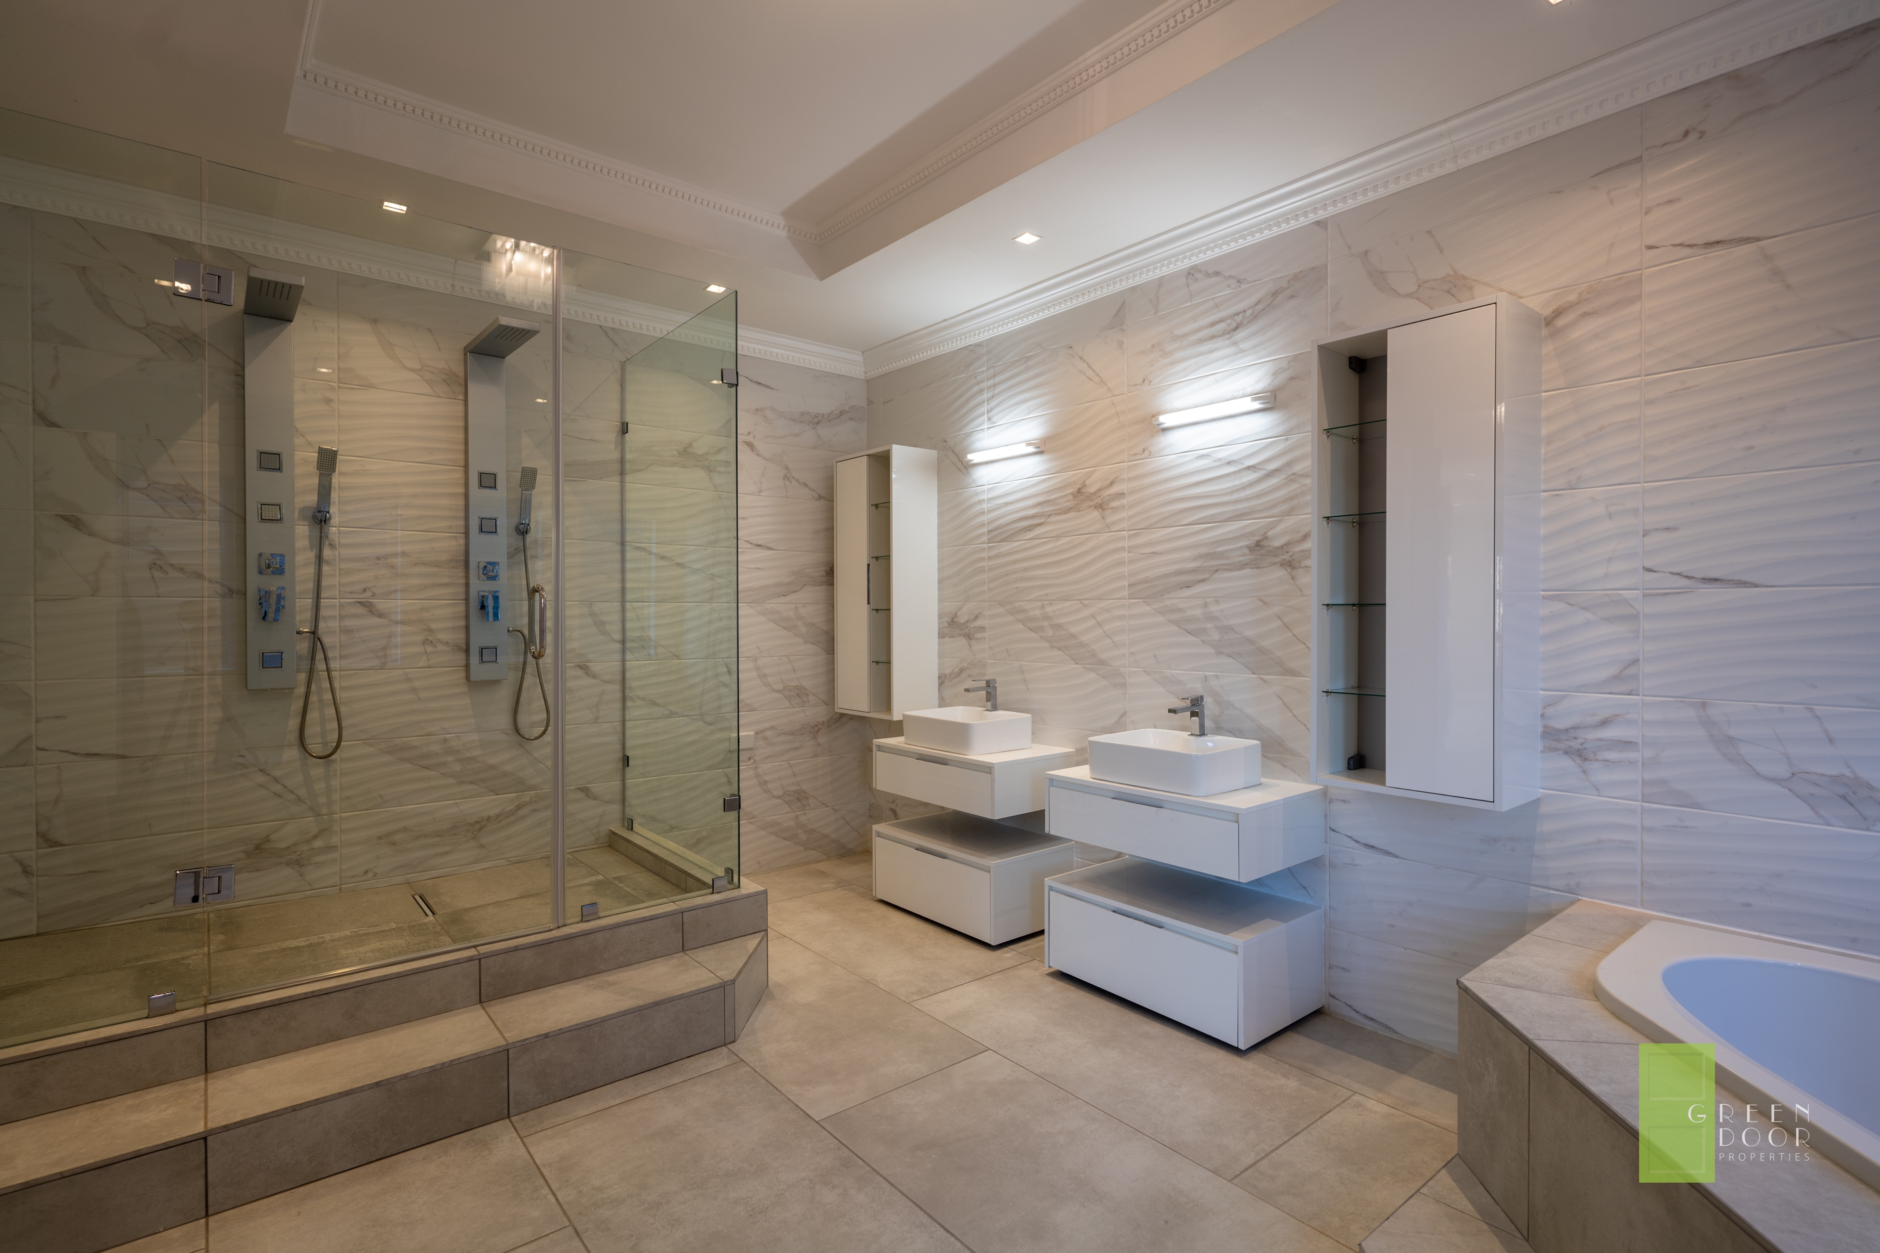
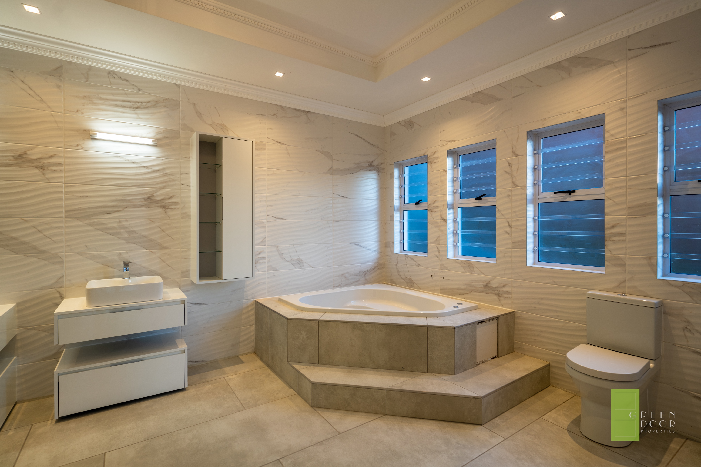
HOME 1 – MAIN EN SUITE

Slide 14
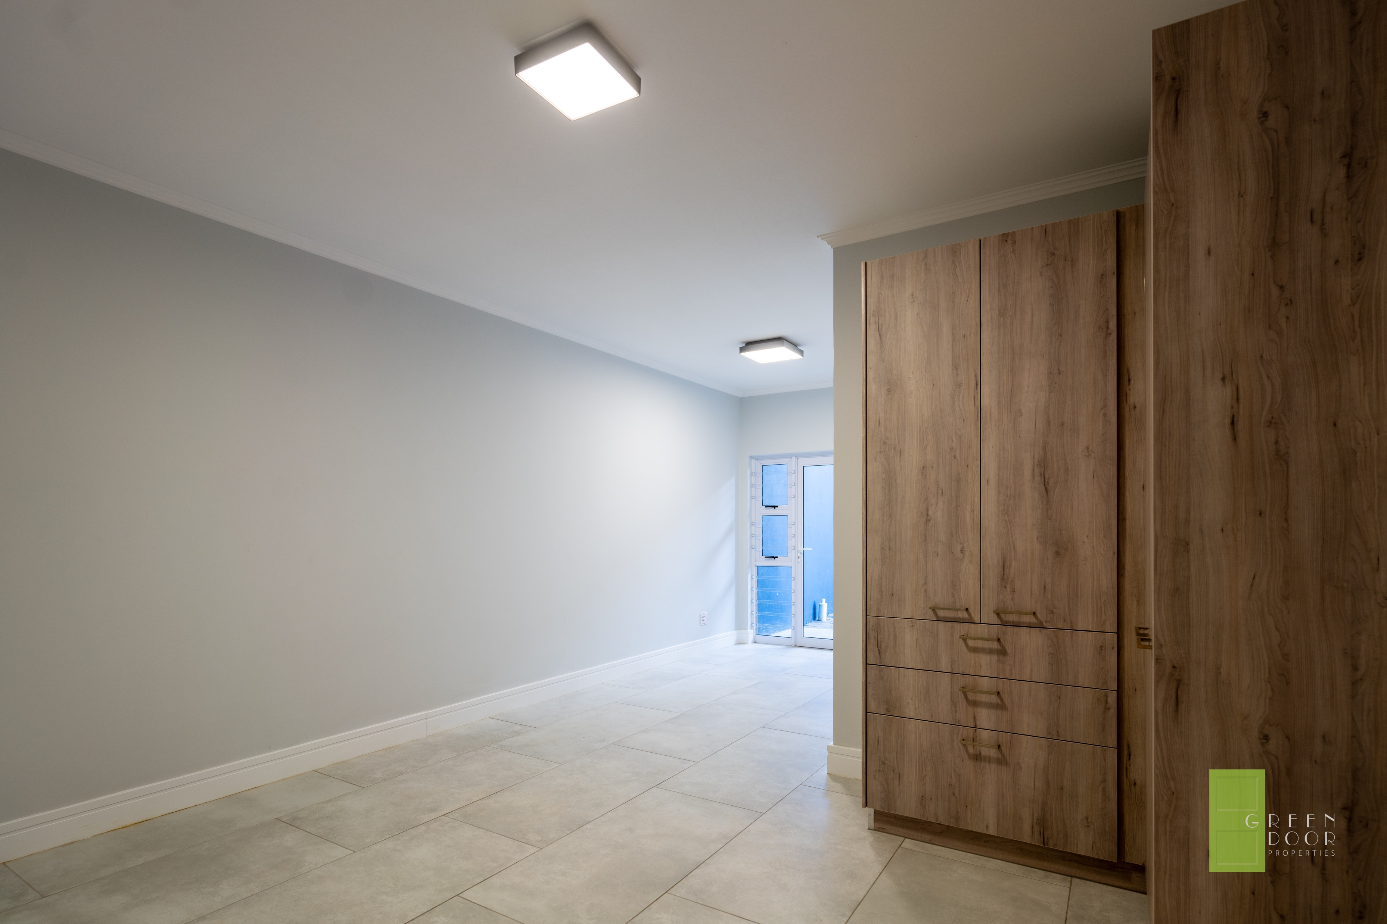
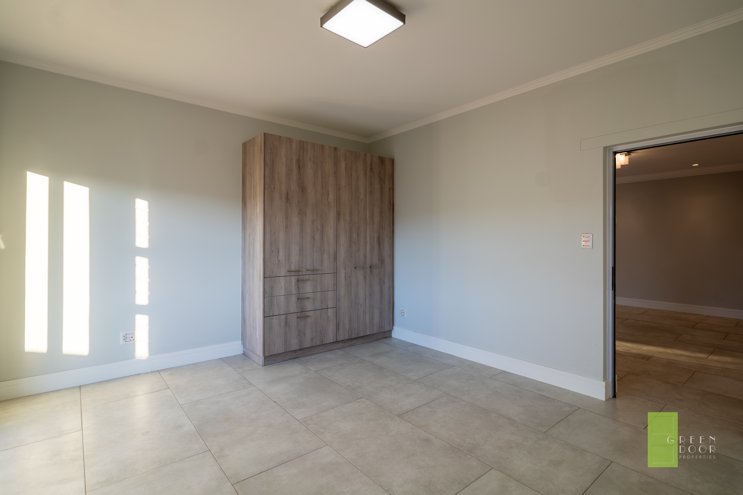
HOME 1- BEDROOM 2 & 3

Slide 15
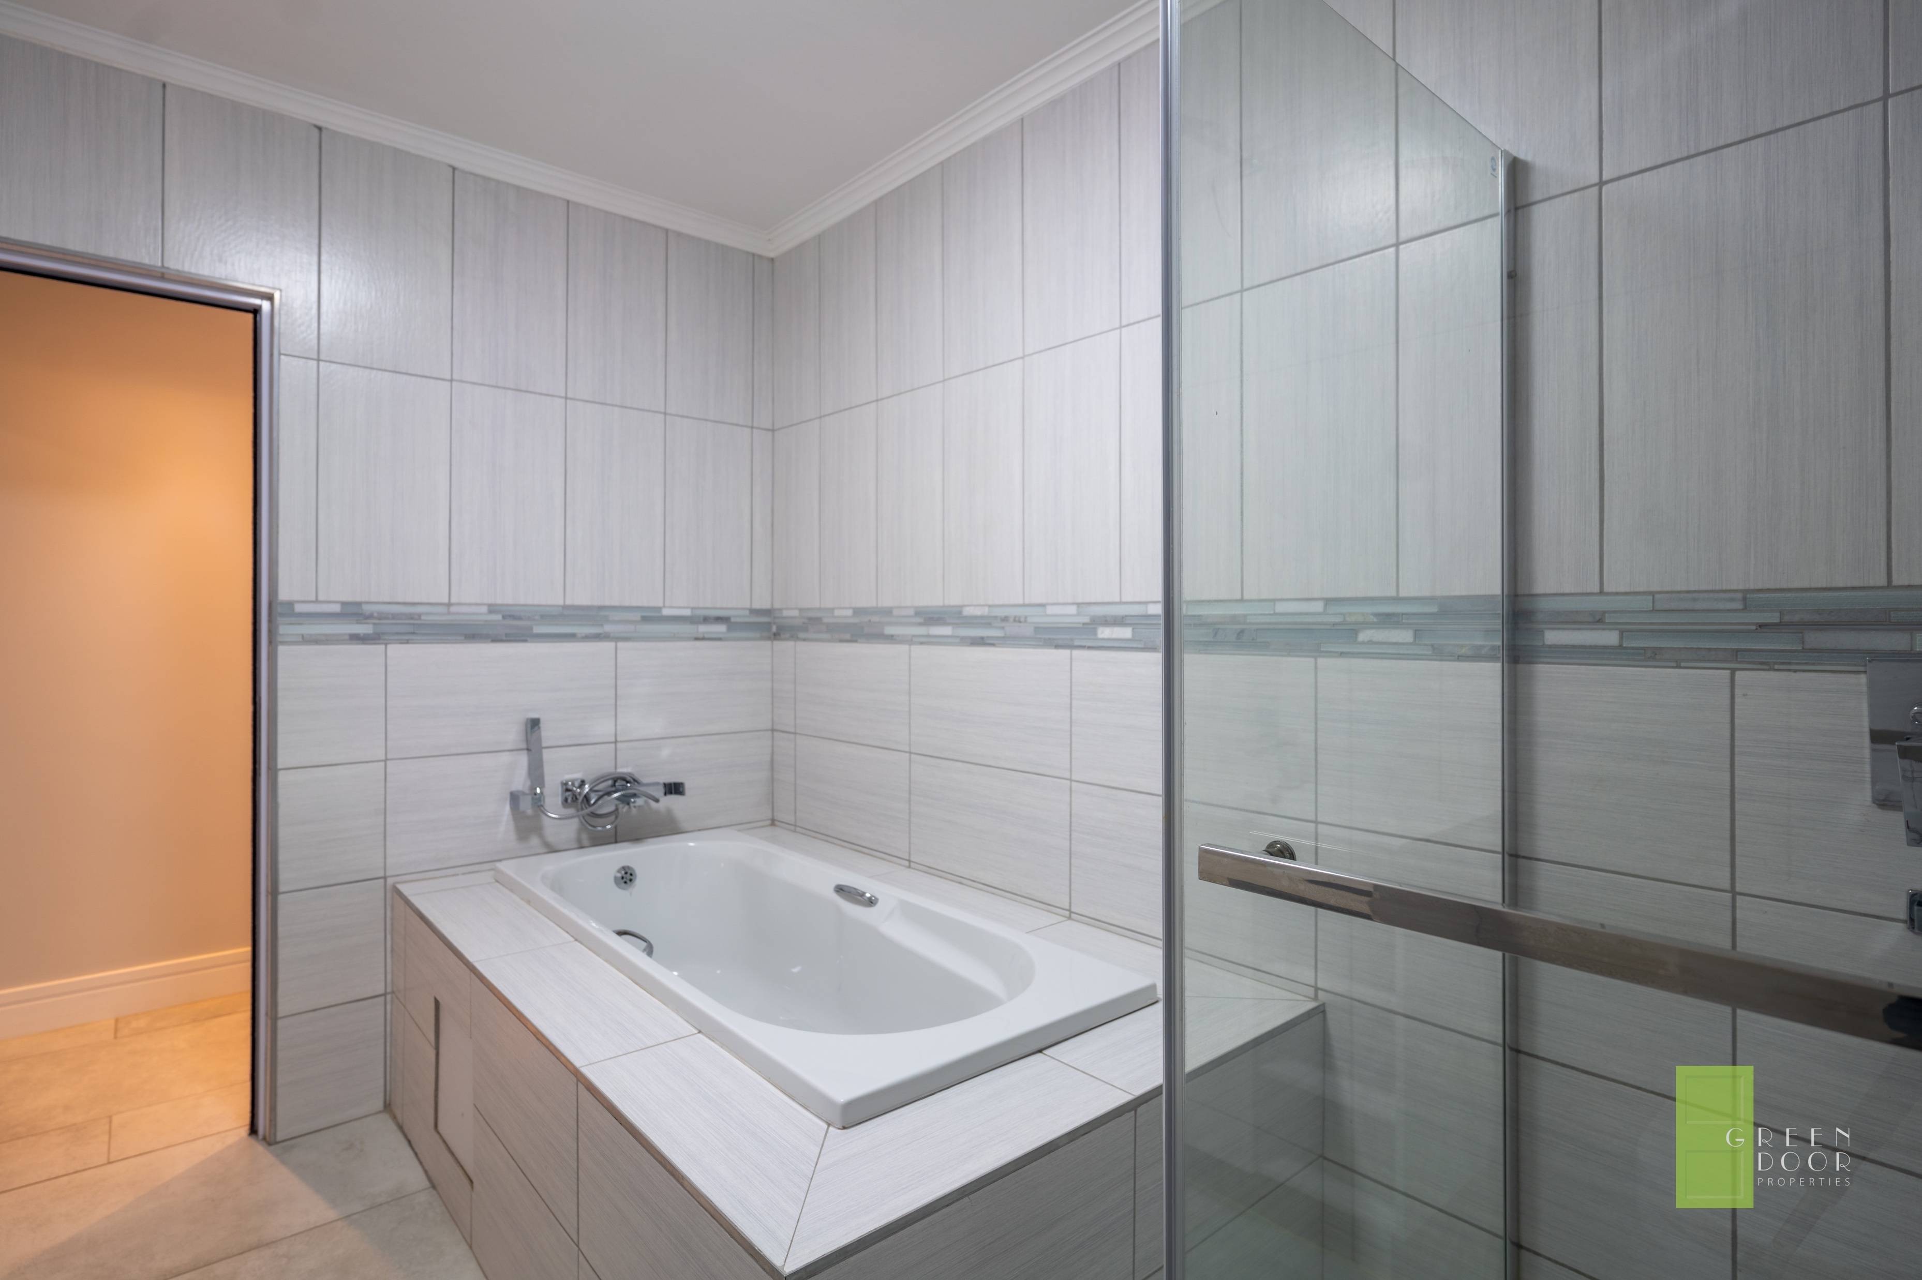
SHARED BATHROOM - BEDROOM 2 & 3

Slide 16
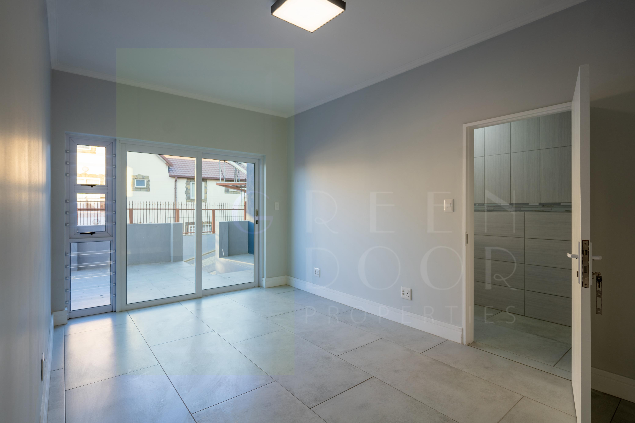
BEDROOM 4 WITH ON-SUITE AND BALCONY

Slide 17
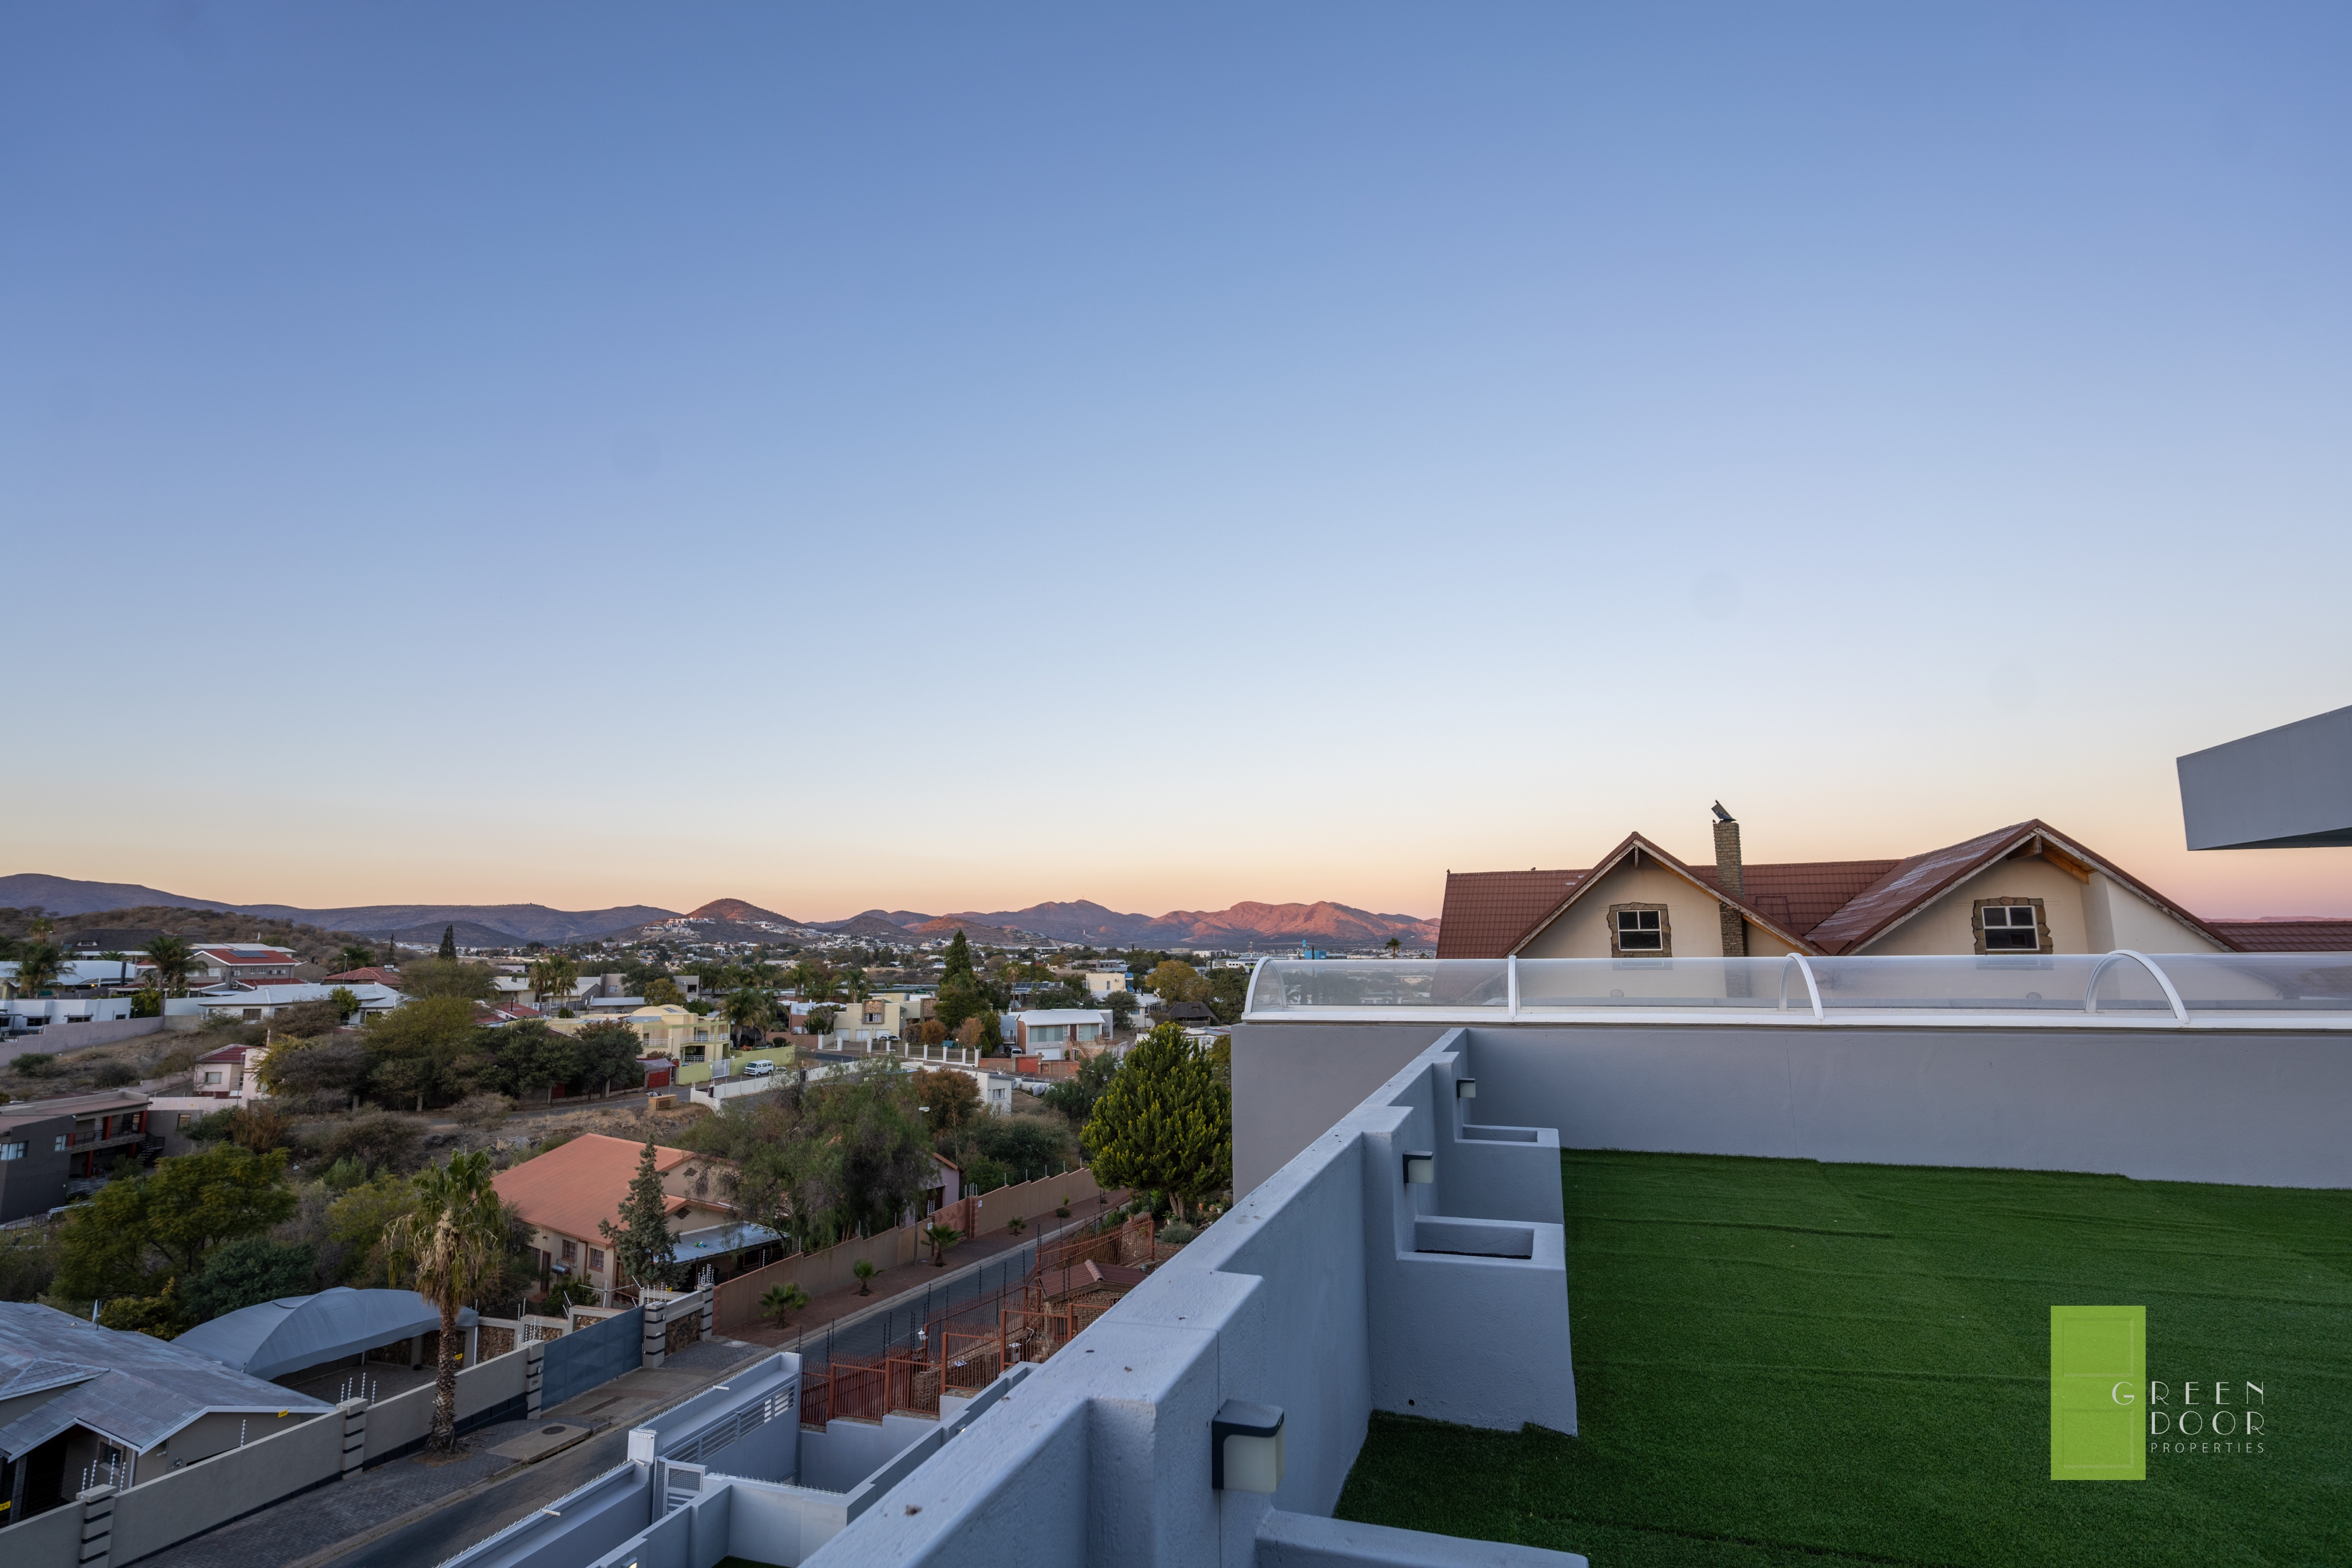
ROOFTOP VIEW TO THE SOUTH

Slide 18
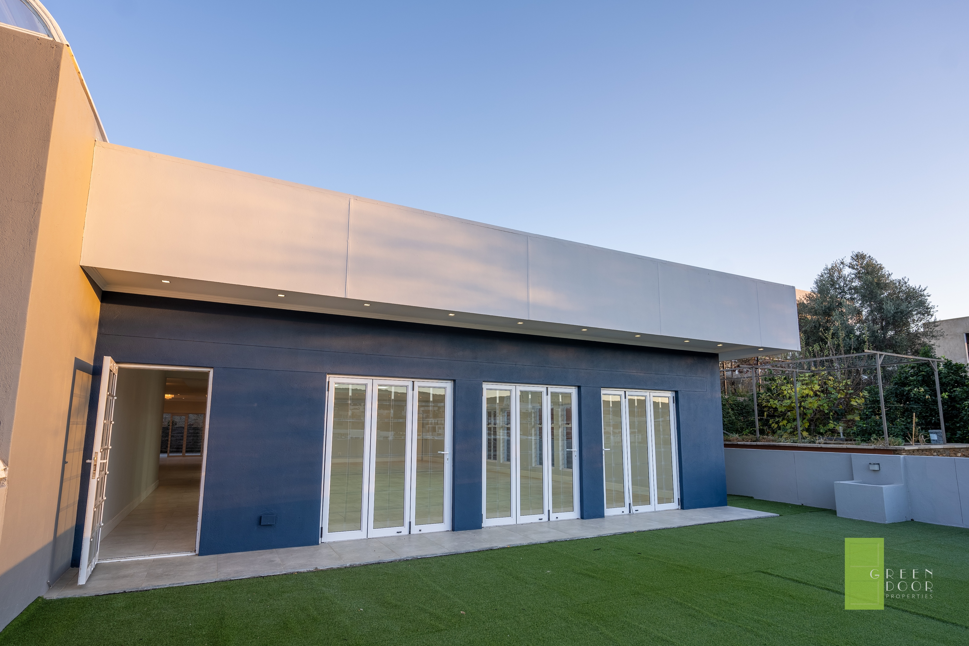
KITCHEN/DINING AREA GLASS DOORS TO ROOFTOP

Slide 19
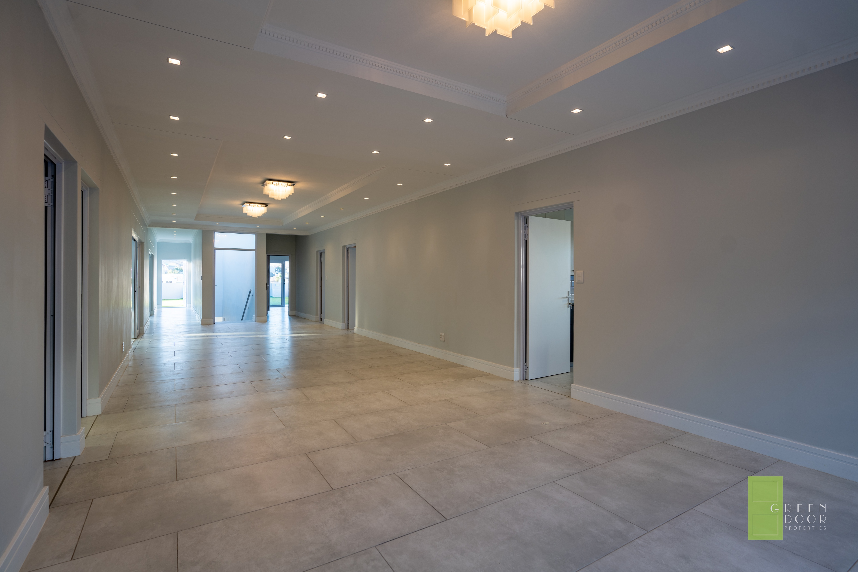
HOME 2 – HALLWAY AND DINING AREA

Slide 20
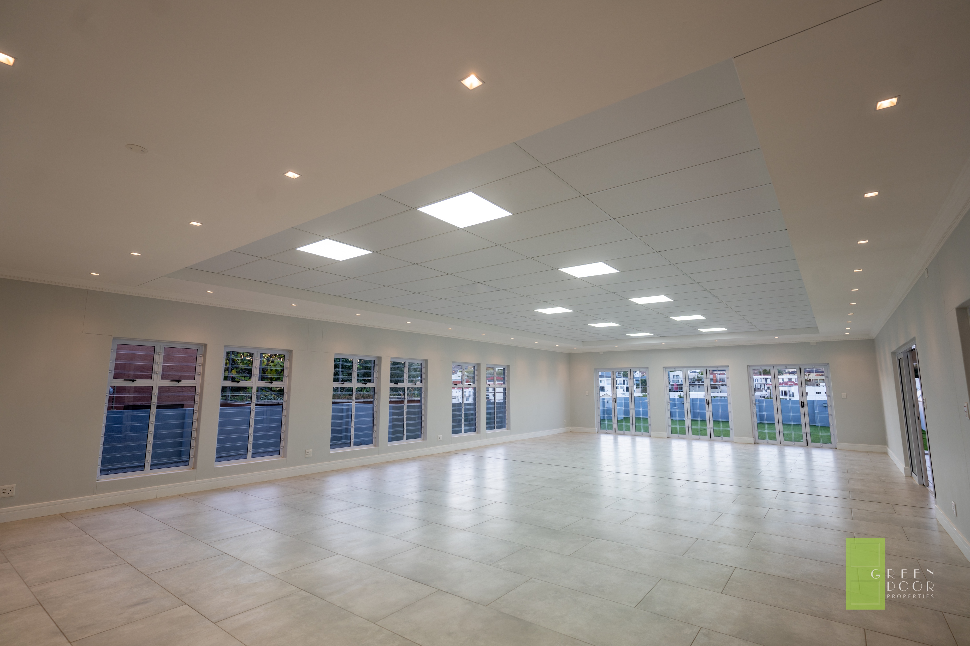
HOME 2 – ENTERTAINMENT / OFFICE AREA 117 SQM

Slide 21
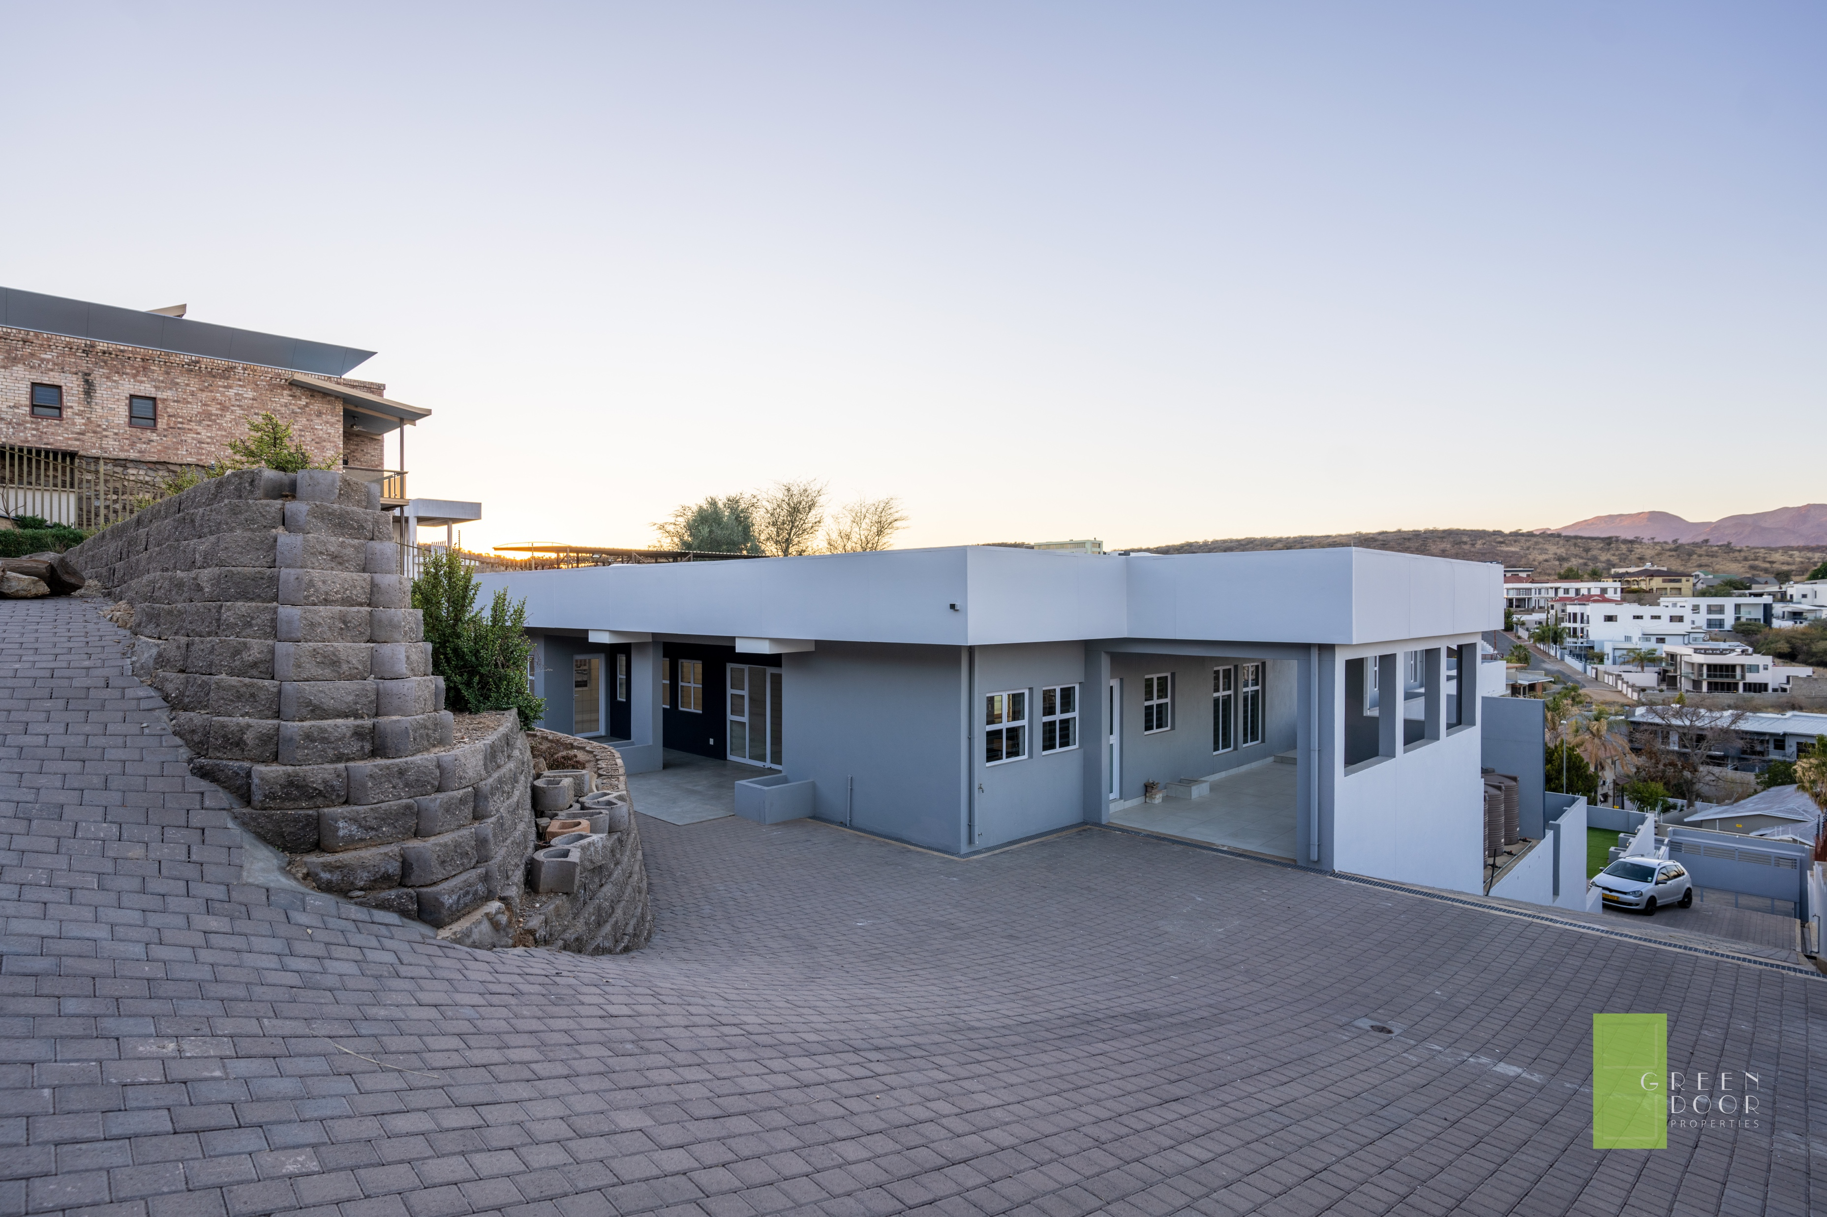
HOME 2 WITH OWN ENTRTANCE

Slide 22
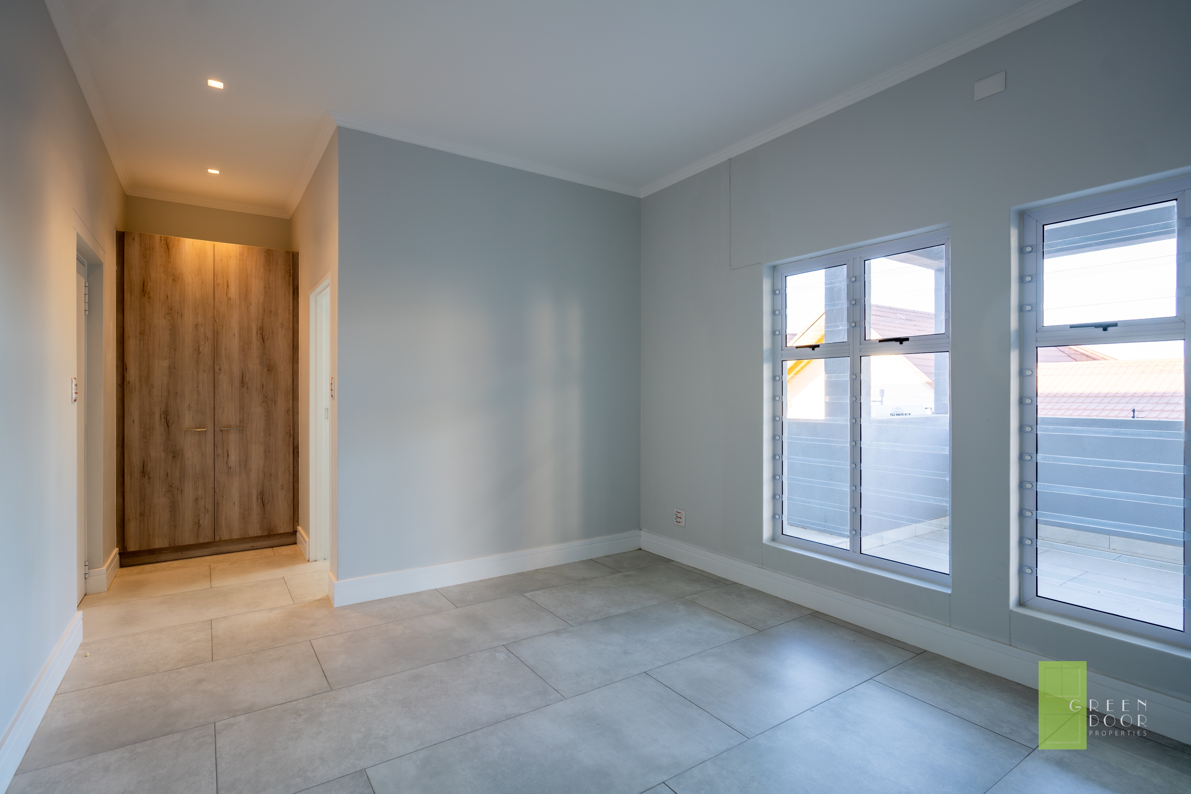
HOME 2 – BEDROOM 2

Slide 23
HOME 2 – MAIN BEDROOM

Slide 24
HOME 2 – MAIN ON-SUITE

Slide 25
HOME 2 - KITCHEN

Slide 26
HOME 2 - OFFICE

Slide 27
LOWER LEVEL FLAT

Slide 28
LOWER LEVEL FLAT

Slide 29
GARAGE & OFFICE

Slide 30
GARDEN & PARKING AREAS

Slide 31
FLOOR PLANS

Slide 32

GLENDA BOSCH
GREEN DOOR PROPERTIES
+264 81 124 2358
glenda@greendoorproperties.co
www.greendoorproperties.co

